Slide 1

Indian Institute of Information Technology
Department of Computer Science and Engineering Nagpur – 441108, India
INDIAN AGRICULTURAL ANALYSIS
DATA HANDLING VISUALIZATION
USING POWER BI AND PYTHON
Project By:
Tsewang Stanzin (BT23CSD017)
Mithravardhan PN (BT23CSD025)
Shubham Jee Shrivastav (BT23CSD033) Varad Patil (BT23CSD061)
Under the Supervision of Mr. Santosh Kumar Sahu Assistant Professor​​

Slide 2
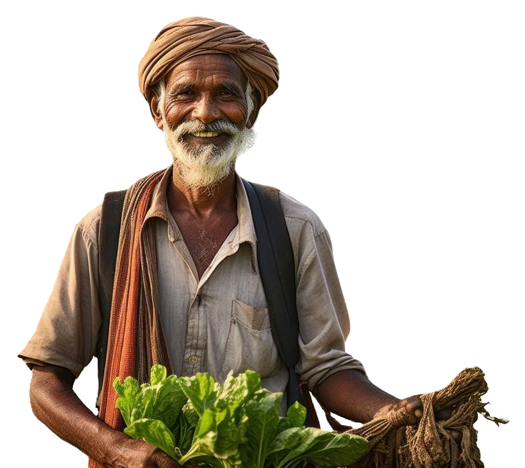
INDIAN
AGRICULTURAL
ANALYSIS
Here is where our presentation begins

Slide 3
Contents
Workflow/Folder structure
Getting data / data description
01
02
Processing data
EDA / Analysis
03
04
Visualizations
Power bi
05
06
findings / insights
07

Slide 4

01
WORKFLOW / FOLDER STRUCTURE
PROJECT FILE TREE:
RAW DATA
ICRISAT-District Level Data
PROCESSED DATA
PRODUCTION
AREA
YIELD
NOTEBOOKS
NOTEBOOK
OUTPUT
CHARTS AND VISUALS
POWER BI

Slide 5
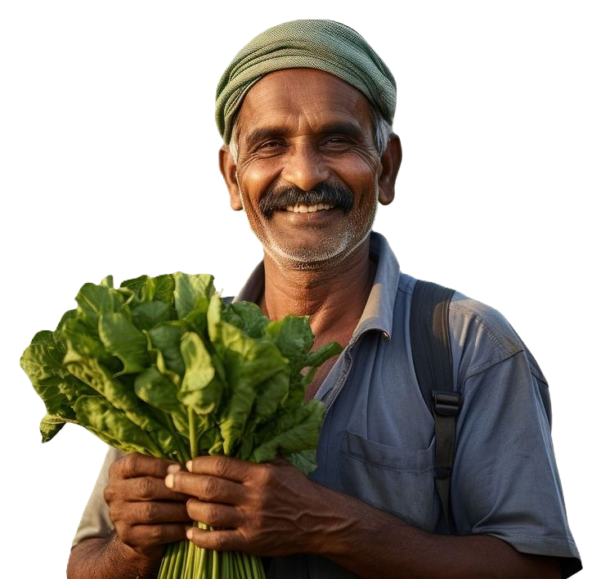
WORKFLOW
DOWNLOAD DATA FROM: website
DATA TO NOTEBOOK:
DIVIDE THE DATA INTO PARTS / PREPROCESSING:
AREA:
- columns related to area ,year, state code, state name and district code
- clean noise and columns names ( to make relations in power bi)
- convert into csv file ( area.csv )
PRODUCTION:
- columns related to productions ,year, state code, state name and district code
- clean noise and columns names ( to make relations in power bi)
- convert into csv file ( production.csv )
YIELD:
- columns related to yield ,year, state code, state name and district code
- clean noise and columns names ( to make relations in power bi)
- convert into csv file ( yield.csv )
Save all the data to processed data folder
EDA
VISUALIZATION
INSIGHTS/FINDINGS
Get Data in power bi:
import all the data from processed data folder
make visualizations

Slide 6
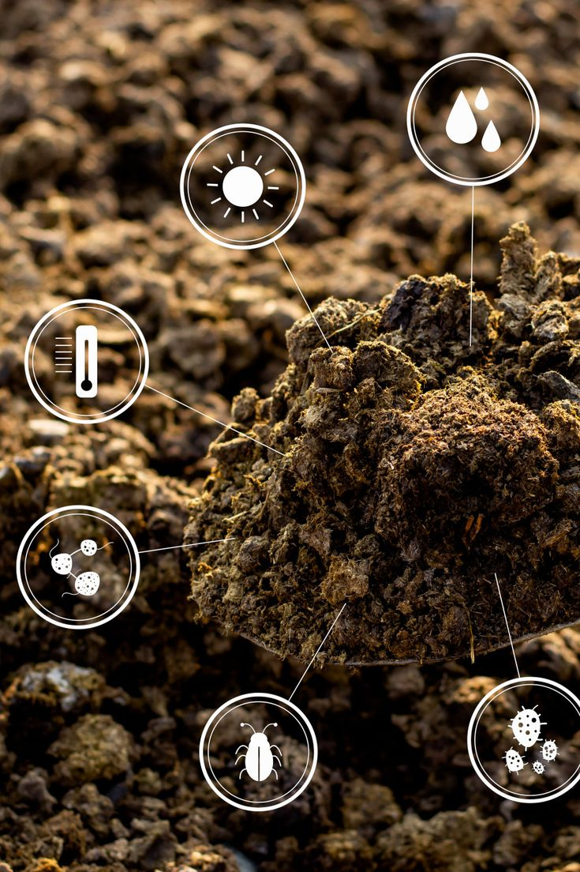
02
Description

Slide 7
Problem Description
Problem:
India's agriculture plays a vital role in its economy. However, productivity and growth rates in agriculture vary significantly across regions and crop types. The key challenges include:
Inconsistent crop yield predictions
Difficulty in identifying high-performance crops across states
Lack of insights into trends and growth projections in crop production
Goal:
To analyze and predict the area and yield of different crops in India, identify trends, and provide actionable insights for policy-making, resource allocation, and agricultural planning.

Slide 8
Application
Application:
This analysis can be used by:
Government Agencies: To track crop production, set policy goals, and allocate resources.
Farmers: To predict potential yield and plan for future seasons.
Agricultural Economists: To study the impact of crop yield on the economy.
Agribusiness: For investment and strategic decisions based on crop performance trends.

Slide 9
Data Description
Dataset Overview:
The dataset contains agricultural data for multiple crop types in India, including:
Crop Type: Different types of crops such as Rice, Wheat, Sorghum, Barley, Cotton, etc.
Year: Data spanning across different years, typically showing annual agricultural performance.
Area (1000 Ha): The land area covered by each crop type.
Production (Metric Tons): The amount of crop produced per year.
Yield (Kg/Ha): The yield per hectare for each crop type.
Dataset link: Indian Agriculture Dataset

Slide 10
Data Source:
The data is collected from government agricultural reports, state-wise agricultural surveys, and other public agricultural databases.
Data Structure:
The data is organized into categories like area , production and yield and columns for each crop type, with each row representing a specific year for a district in states in India.

Slide 11
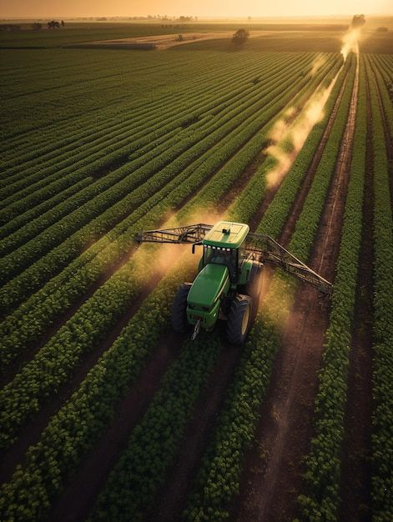
03
Basic Data Wrangling/Munging/Preprocessing Steps

Slide 12
Data Cleaning:
There were no missing values and duplicated rows in dataset.
Corrected inconsistencies in column names (e.g., ensuring uniformity in crop names).
Standardized units of measurement for area, production, and yield.

Slide 13
Dividing the data set
The whole dataset was divided into three other datasets based on categories like Area , production and yield which improved the analysis of data through power BI and visualizations

Slide 14

4
EDA / analysis

Slide 15
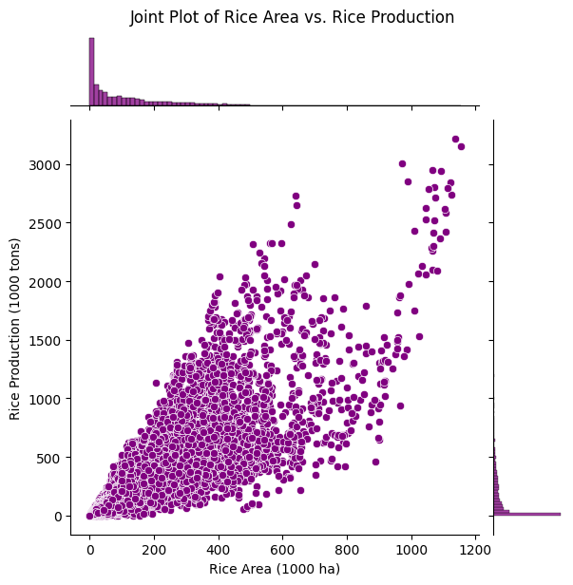
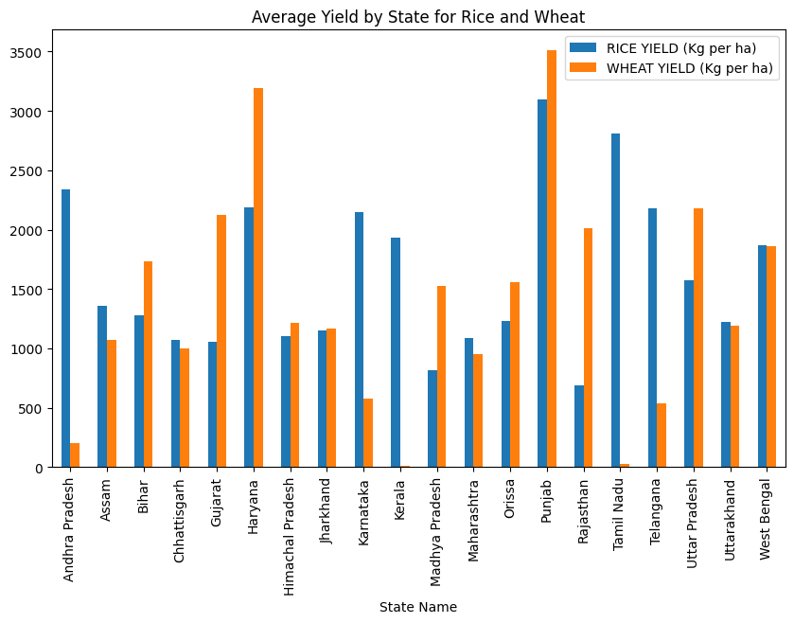
The joint plot shows a positive correlation between rice area (in 1000 ha) and rice production (in 1000 tons). As the area used for rice cultivation increases, production generally rises, with a few outliers achieving high production levels even with smaller areas. The density plots indicate a high concentration of data points in lower area and production ranges.
The graph shows Punjab leading in both rice and wheat yields, with Haryana and Uttar Pradesh strong in wheat. States like West Bengal and Andhra Pradesh excel in rice but have lower wheat yields. Kerala and Tamil Nadu show minimal wheat yield, indicating regional crop preferences.

Slide 16
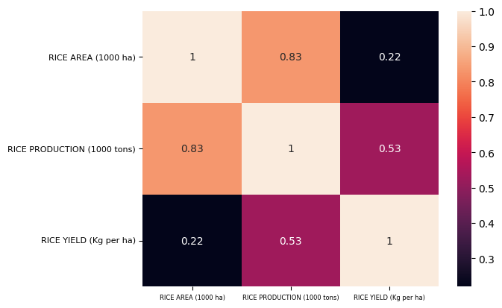
Similarly we can check for correlation between area,, production and yield of any crop type since there are more than 75 types of crops we chose to show only for rice
1. Rice Area and Rice Production (0.83) – more area generally leads to higher production.
2. Rice Production and Rice Yield (0.53) – moderate correlation, suggesting yield impacts production but is less influential than area.
Rice Area and Rice Yield show a weak correlation (0.22), indicating yield does not heavily depend on the cultivated area.

Slide 17
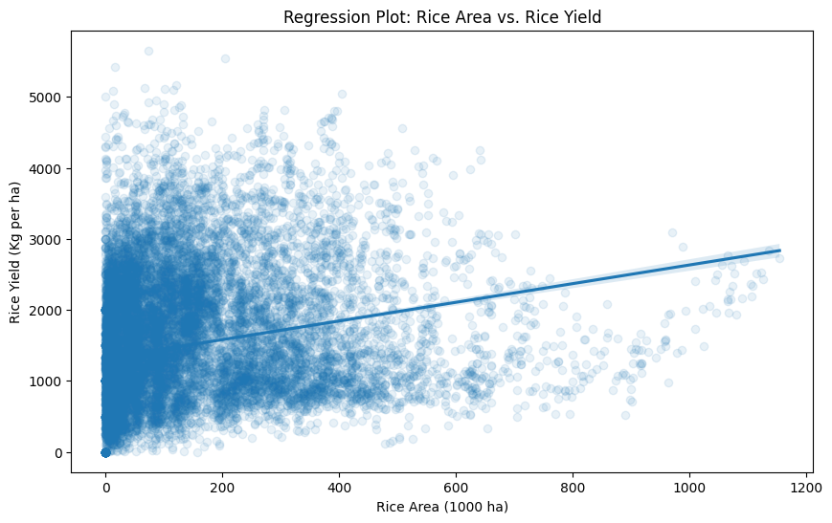
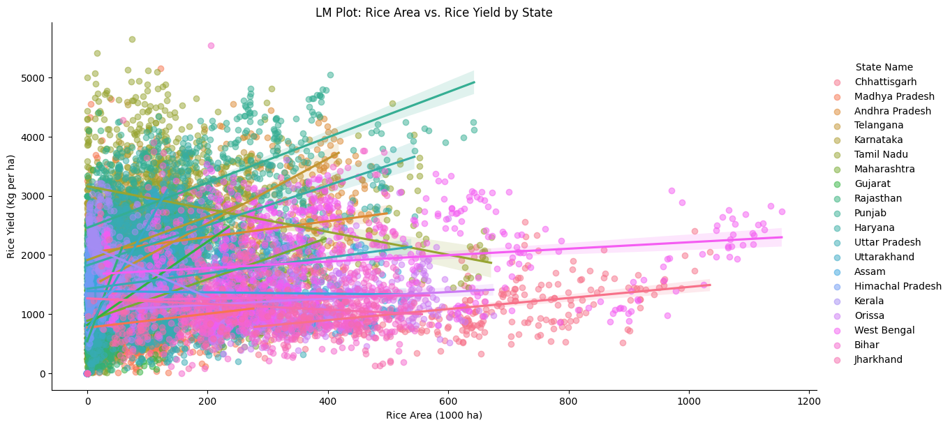
This regression plot shows the relationship between rice area (in 1000 ha) and rice yield (in kg per ha). There is a slight positive correlation, indicating that as the area under rice cultivation increases, yield also tends to increase, but the effect is not strong. Most data points are concentrated at lower area and yield values, with only a few instances of high area and high yield. This suggests that while expanding rice area can contribute to yield, other factors likely play a significant role in influencing productivity.

Slide 18
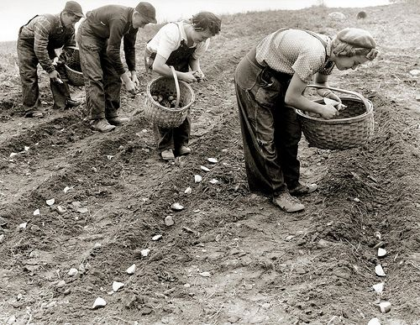
5
Visualizations

Slide 19
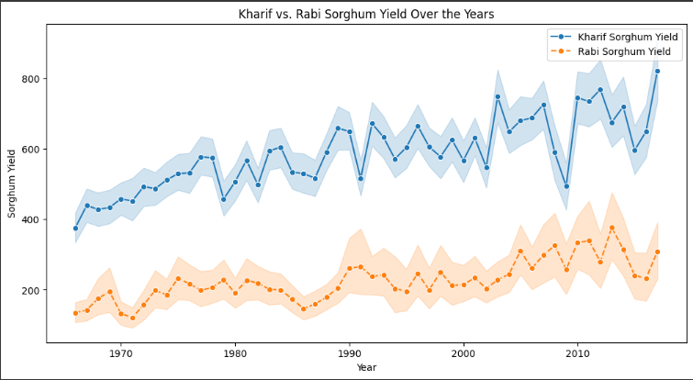
1.What is the variation of Sorghum yield over years in kharif and Rabi seasons ?
This comparison suggests that Kharif Sorghum is more susceptible to climatic fluctuations, while Rabi Sorghum benefits from relatively consistent growing conditions, resulting in steadier yield performance over the years.

Slide 20
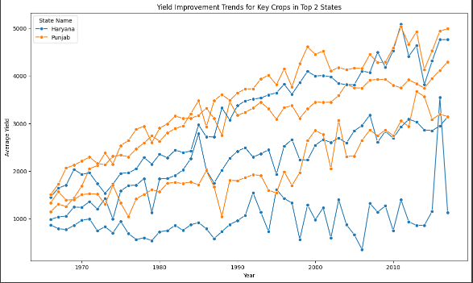
2. Which are the top 2 states by the highest average yield across the key crops ?
These states set a benchmark, highlighting areas with optimal crop yields that other states may aspire to replicate for improved agricultural outcomes.

Slide 21
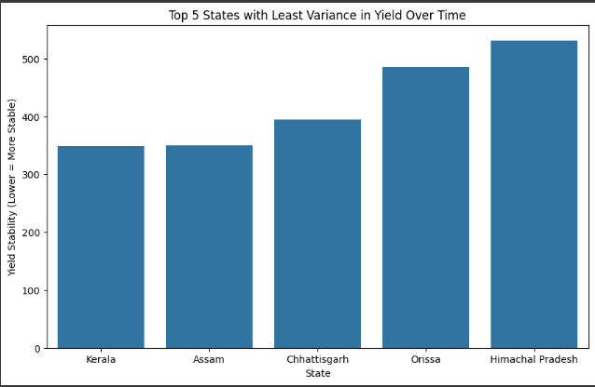
3. Which are the top 5 states with least variation in yield over time?
These states may benefit from stable weather patterns, effective irrigation systems, or advanced crop management techniques. Their consistent yields over time suggest that they are better positioned to manage risks and ensure reliable crop production annually.

Slide 22
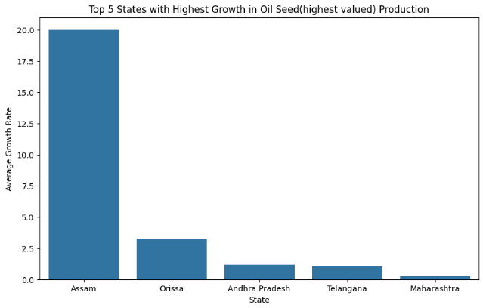
4. Which are the top 5 states with the highest growth rate in oil seed production?
This growth trend suggests that these states are capitalizing on market opportunities and may continue to be pivotal in meeting the country's oilseed requirements, contributing to both regional economic growth and national agricultural productivity.

Slide 23
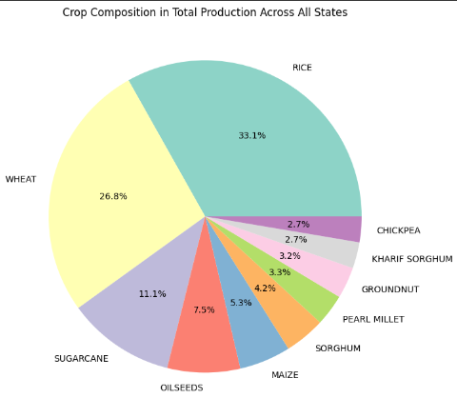
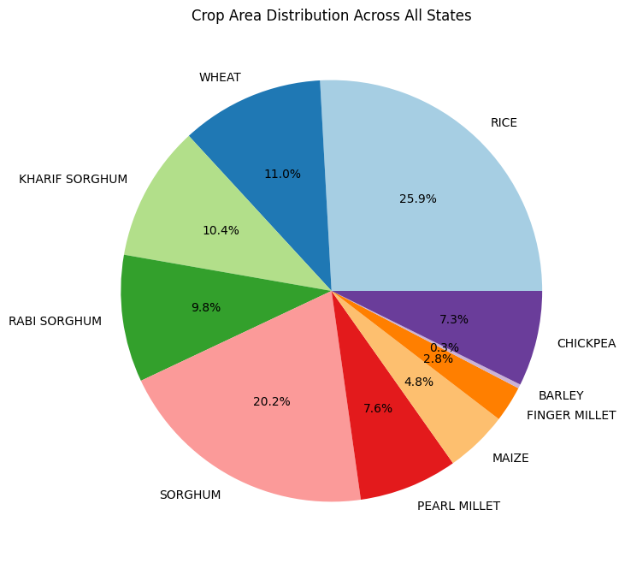
5. What is the crop composition in terms of total production and area across all states ?
This distribution provides insights into crop prioritization, showing which crops are widely cultivated and essential to food security and economic stability. By identifying high-production crops, policymakers and agricultural planners can focus on sustaining and improving these key crops for balanced agricultural growth.

Slide 24
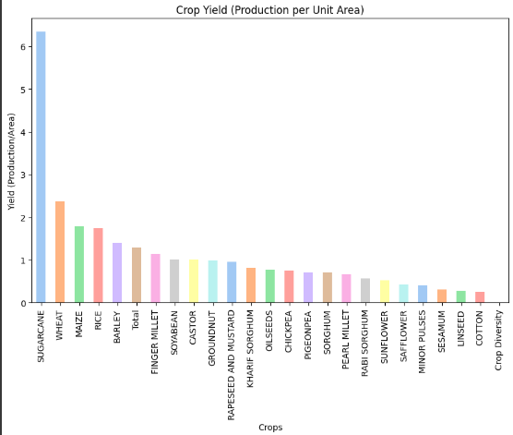
6. Which crops dominate in terms of yield (production / area) in all states ?
These high-yield crops are critical for optimizing agricultural productivity, especially in regions with limited arable land. Their dominance in yield highlights their potential to contribute significantly to food security and resource-efficient farming practices, making them prime candidates for further investment and research to sustain and enhance productivity.

Slide 25
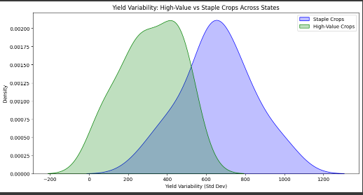
7. Comparing the yield variability for high valued crops vs staple crops
This comparison underscores the trade-off between the higher risks associated with high-value crops and the reliable, but less profitable, production of staple crops.

Slide 26
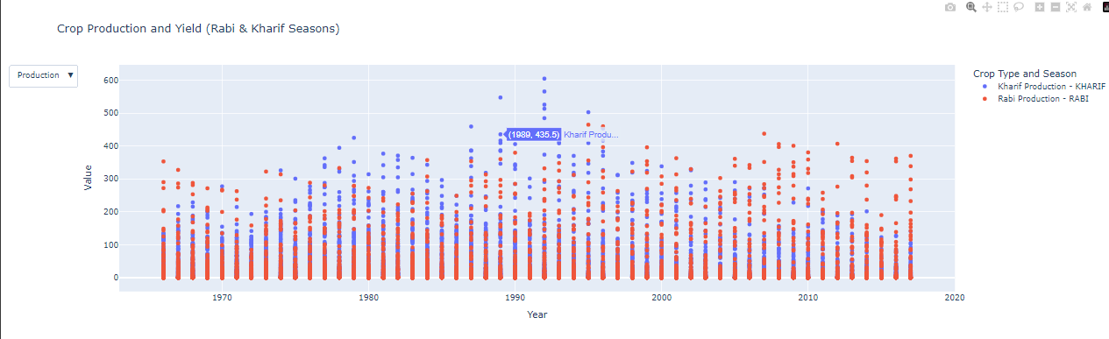
8. Crop Production and yield through Kharif and Rabi seasons
This seasonal distinction highlights the importance of adjusting agricultural practices to suit each season's unique challenges and opportunities for maximizing crop output.

Slide 27
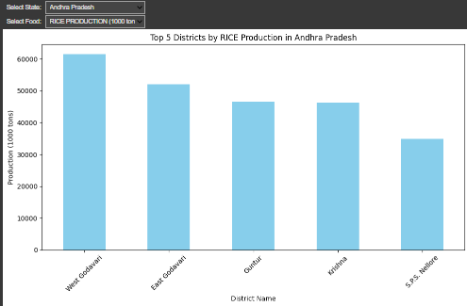
9. Which are the top 5 districts with the highest production of a certain crop in certain state?
These districts play a crucial role in driving the state's agricultural output, and understanding their contributions can help optimize resource allocation, improve infrastructure, and design targeted agricultural policies to enhance productivity in these high-yielding regions.

Slide 28
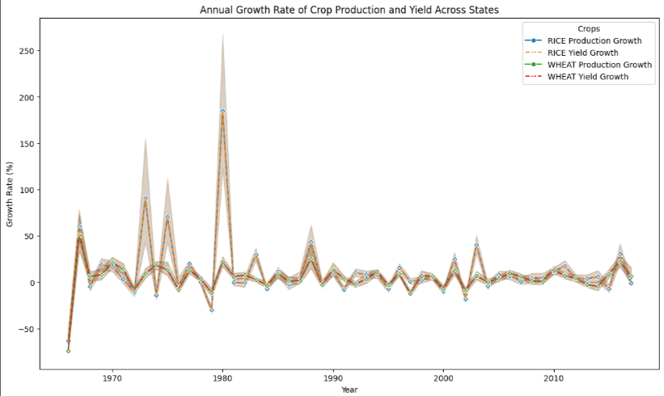
10. What is the annual growth rate of crop production and yield across states ?
States with higher growth rates in production and yield indicate improving farming practices, adoption of technology, or favorable climatic conditions, while states with slower growth may need targeted interventions. This analysis helps policymakers identify regions for investment and improvements, ensuring sustainable agricultural growth and enhanced food security across the country.

Slide 29
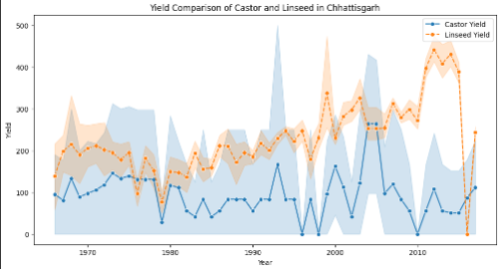
11. Comparison of two particular crops in a particular state
This comparison can highlight which crop is more suited to the local climate and soil conditions, offering valuable insights for resource allocation, crop rotation planning, and strategic agricultural decisions. Understanding these dynamics helps farmers and policymakers optimize crop selection to boost productivity and profitability in the given region.

Slide 30
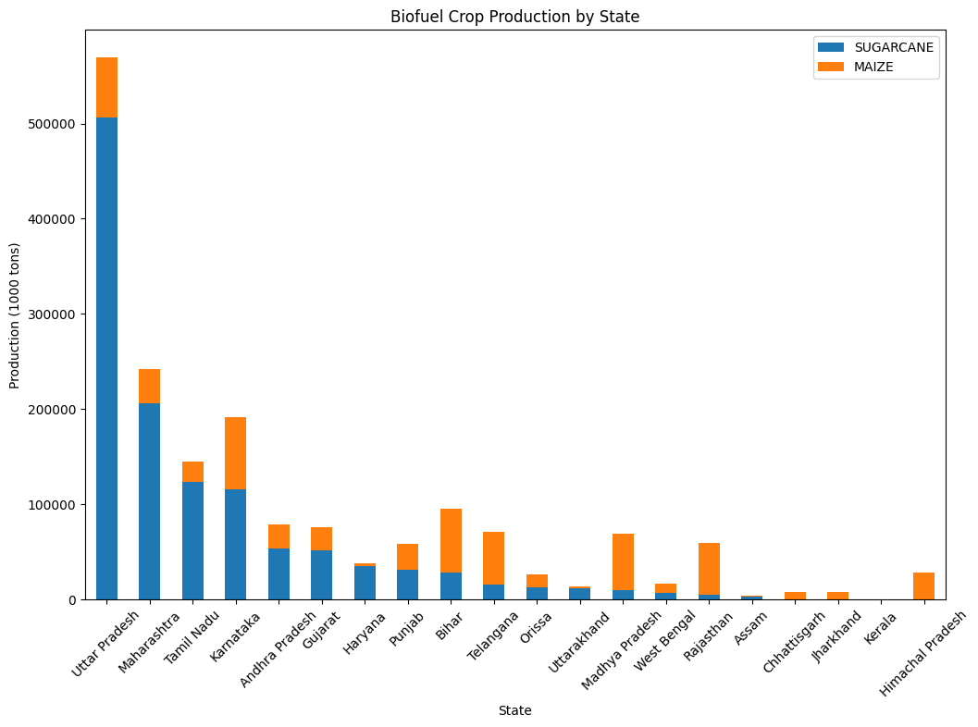
13.What is distribution of biofuel crops across states ?
This distribution is crucial for understanding regional contributions to the country's biofuel goals and helps inform policies related to sustainable energy and agricultural practices

Slide 31
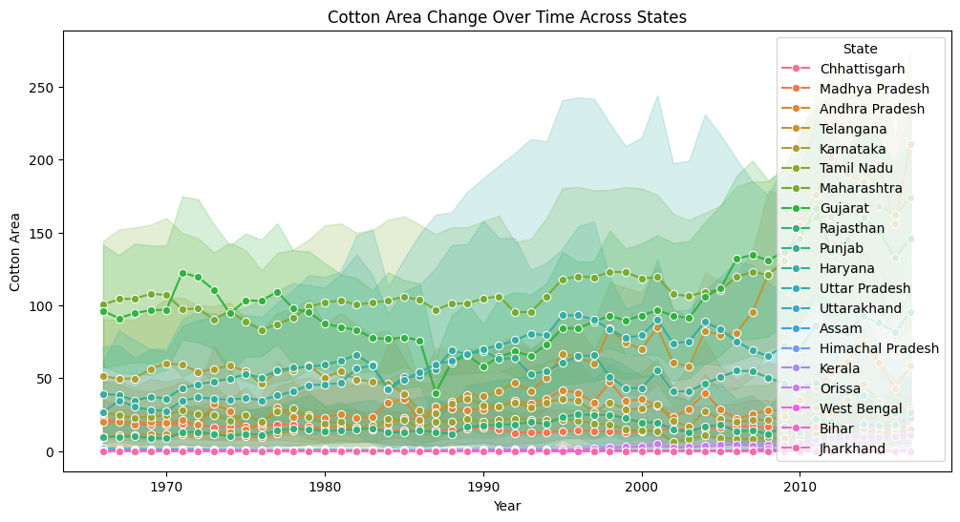
14. How did the cotton area change across states over time ?
States with a growing area of cotton cultivation likely reflect increased demand for the crop, while those with a decreasing area may indicate challenges such as water scarcity, pest management issues, or competition with other crops. This analysis provides insights into regional agricultural adaptations and highlights areas where targeted interventions could sustain or revitalize cotton farming.

Slide 32
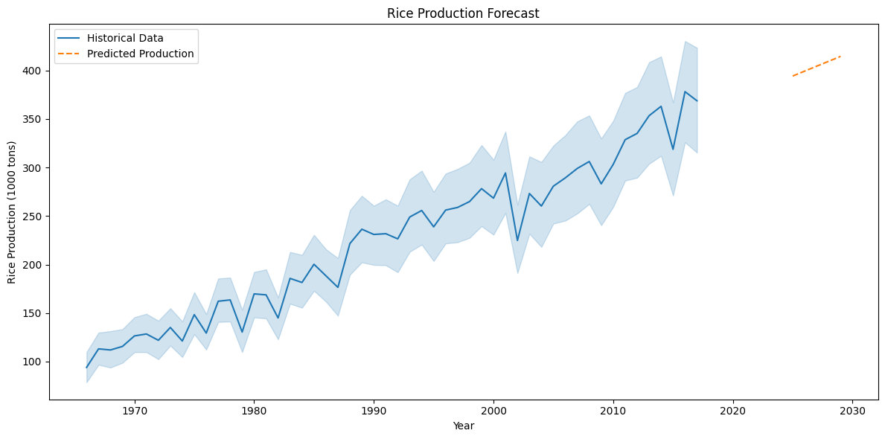
15.Rice production forecast
The forecast for rice production suggests that future trends will be shaped by various factors, including climatic conditions, technological advancements in farming, and the adoption of improved irrigation techniques.

Slide 33
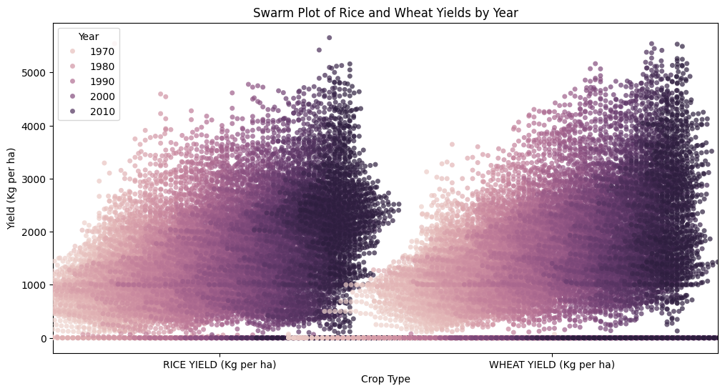
This swarm plot shows that both rice and wheat yields increased from 1970 to 2010, with wheat yields generally higher than rice. The density of data points increases in recent years, indicating yield improvements and greater variability, likely due to advances in agricultural practices. The shift of points higher on the y-axis over time reflects overall growth in crop yields.

Slide 34
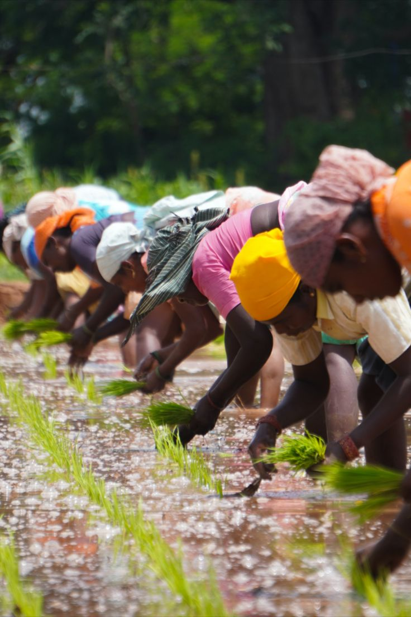
6.Power BI
Dashboard

Slide 35
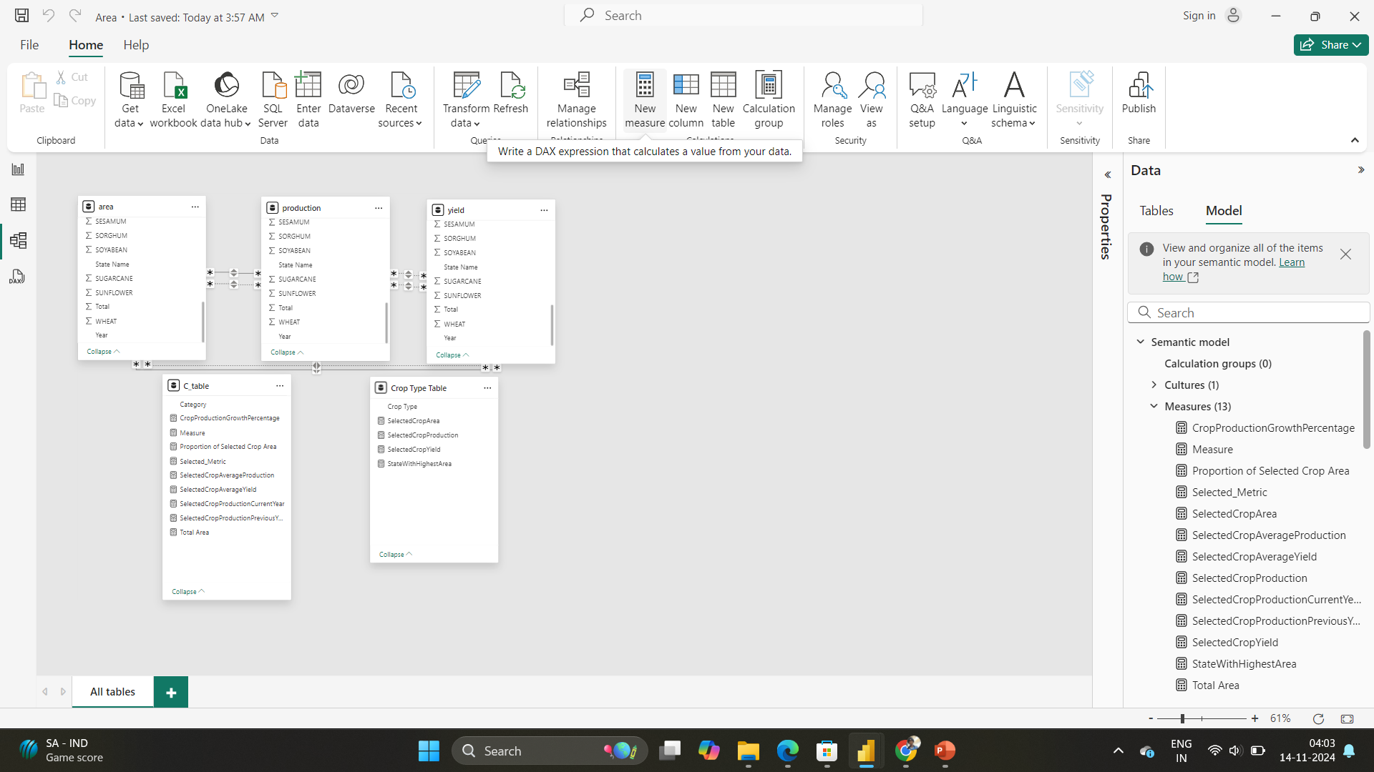

Slide 36
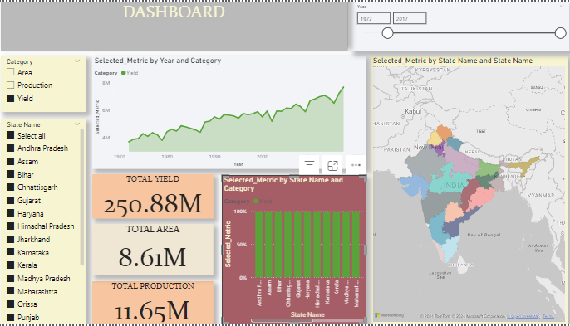
"

Slide 37
-> Slicers :
-> Plots :
-> Cards:
-> Filled Map:
-> A slicer is added to select the category ie Area / Production / Yield
-> A slicer is added to select the state
-> A slicer to adjust year
-> A line plot is added to display the distribution of selected category over years
-> A bar plot is added to display the distribution of selected category over states
-> Cards added for Total area , production and yield
-> A filled map representing the selected category and state with year

Slide 38
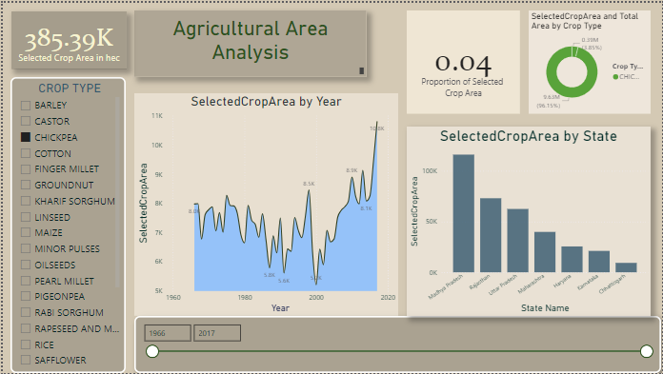
"

Slide 39
-> Slicers :
-> Plots :
-> Cards:
-> A slicer is added to select the crop type
-> A slicer to adjust year
-> A line plot is added to display the distribution of selected crop type over years
-> A bar plot is added to display the distribution of selected category over states
-> A donut plot to display the proportion of selected crop area out of total area
-> Cards added for total selected crop area
-> One for proportion of area of selected crop area by total area

Slide 40
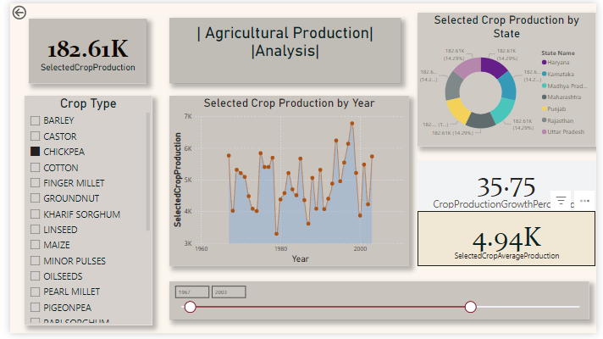
"

Slide 41
-> Slicers :
-> Plots :
-> Cards:
-> A slicer is added to select the crop type
-> A slicer to adjust year
-> A line plot is added to display the distribution of selected crop type over years
-> A donut plot to display the distribution of selected crop production around states
-> Cards added for Total selected crop production
-> One for average production of selected crop and one for percentage of growth of selected crop production

Slide 42
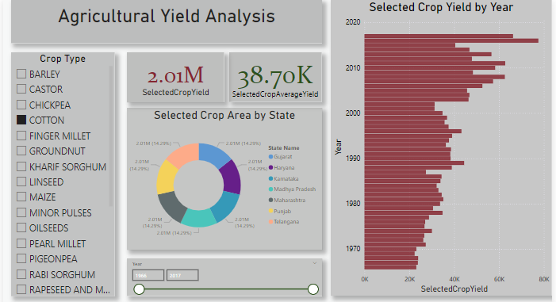
"

Slide 43
-> Slicers :
-> Plots :
-> Cards:
-> A slicer is added to select the crop type
-> A slicer to adjust year
-> A bar plot is added to display the distribution of selected crop type over years
-> A donut plot to display the distribution of selected crop yield around states
-> Cards added for Total selected crop yield
-> One for average yield of selected crop and

Slide 44
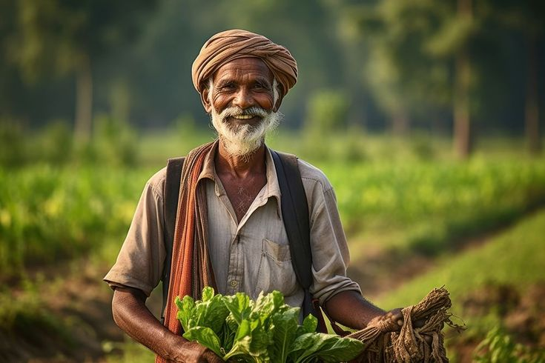
7.Outcomes

Slide 45
Outcome
Sorghum has more than 20 percent of the total cultivated land but have only 9 percent in total produced crops in the country.
sugarcane is best to produce when in terms of Yield.
Linseed yield production has significantly dropped after 2010 where all others have performed consistently.
we can see the sudden dip in rice production in Chhattisgarh around 1997-1998.
Gujarat has the most of the variation in the cotton production area where Tamil Nadu has performed very consistent in it.
cotton has the overall least production/area in all over the country.
some states like Bihar, Jharkhand, West Bengal has almost no production in cotton for more than 15 years. but now in recent 5-6 years, due to government schemes and awareness for production, these states has performed good in cotton production specifically.

Slide 46
Outcome
the production of kharif crops is decreasing from 1990 till date
you can see the sudden spike before 1970 where we were discovering basic ways to grow crops
we haven't really performed well in innovating productive ways to grow crops(very lenient graph)
in rabi season, sorghum grains have lesser production.
in case of key crops, Punjab is way more consistent than Haryana when we see the data for over 12 years.
more consistent state in terms of good yield production are Kerala, Assam, Chhattisgarh, Orissa , Himachal Pradesh.
Assam has exponential growth in production of oil seed(one of the most valuable crop);

Slide 47

Thank you

